Slide 1
FM1905097
[Not Export Controlled/ ECCNxxx]
AIRBUS AMBER
[ADNS V36PR2407708] A350 ATA 36 PCE Leakage Monitoring (SAR)
Deployment Review
Juan Rodríguez Martínez
14/11/2024

Slide 2
Review panel to be filled-in during the review
AIRBUS AMBER
Deployment review panel
✔
Role | Name & Siglum | Mandatory? | Present? | Comment
Health engineer or representative | Juan Rodríguez | Yes | Yes
Project Leader | David Decouchon | Yes | Yes
Program / support program / Skywise representative | Yves Dupont | Yes | No
Front-End representative / Airtac representative |  | No | No
Engineering Customer Support (1SY) focal point | Marta Díaz Julien Benech | Yes | Yes
Operational expert | Julien Feret | No | Yes
Other | Luis Guillermo Amesty Víctor Pérez | No | Yes
https://docs.google.com/spreadsheets/d/1BqkbXOJ0Fee0x02uknPpDGtD7AvLByUnLOq8a88YaGs/
✔

Slide 3
AIRBUS AMBER
Model history
ATA36_XWB_PCE_LEAKAGE_MONITORING_M0
Jira | Model Version | Tag | Moca | Specification | Version description | Deployment date
SBAOG001-8423 | v1.0 |  | v1.7 | A350 PCE Leakage Monitoring Specification | First version
* For a model update, link to the previous model deployment review to be provided

Slide 4
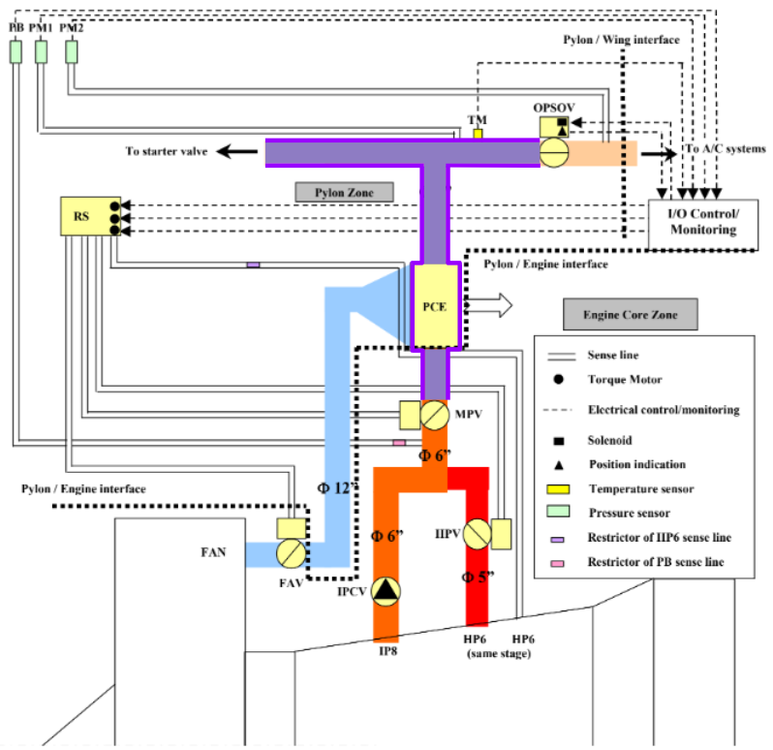
AIRBUS AMBER
Model description
PURPOSE:
Several reported damages on Engine Thrust Reverser Thermal Blanket and Pylon Thermal Blanket due to PCE (pre-cooler exchanger) leaks.
The root cause is an accelerated thermal fatigue caused by additional thermal cycles due to IP-HP switchings in cruise phase not foreseen in the design phase and a PCE leakage velocity above Thermal Blanket qualification levels.
Leaks in the PCE could damage the thermal blankets.
The model objective is to detect leaky PCE by measuring the depressurization time.
SYSTEM DESCRIPTION:
The PCE is used to reduce the temperature of engine bleed, before feeding it to the Air Generation Unit.
If hot air leaks from PCE it can damage the other components inside the pylon.
No active sensor is available to detect air leak from PCE.
At the end of engine start sequence pressurized air from APU is encapsulated in closed volume between MPV, OPSOV and SAV as highlighted in purple in the system diagram below.
PM1 sensor can be used to measure the pressure of this volume .
Small leaks are normal because the volume is not hermetic and the pressure is reduced gradually. However, in case of leaky PCE the air pressure drops drastically.

Slide 5
AIRBUS AMBER
Model description
FAILURE MODE:
Cracks in the PCE lead to faster depressurization of the air inside the volume. The air leaking from the PCE may damage the thermal blankets.
There is no Failure Message related to a leak in the PCE. The only way to confirm a leaky PCE is to perform a Leak Test to the component and check the status of the Thermal Blankets.
DATA SOURCE:
SAR Channel 17
MODEL LOGIC:
The model monitors the time it takes to PM1 to reduce 15 psi of pressure with the following conditions:
  PM1 between 30 psig and 15 psig
  HP6 between 20 psi and 80 psi
  Engine Started less than 30 seconds ago
  APU Bleed Valve open
  Over-Pressure Shut Off Valve (OPSOV) is closed or closes during the monitoring window.
If the pressure drop is less than 3 psig or the depressurization rate is less than 0 psig/second, the monitoring window is considered invalid.
If there are more than 3 events in the last 5 flights with a depressurization time below 3 seconds, the model triggers a MEDIUM LEAK alert.
If there are more than 3 events in the last 5 flights with a depressurization time below 1 seconds, the model triggers a HIGH LEAK alert.

Slide 6
Model information
Program | A350 | Engine Type | ALL
APU type | ALL | ATA6D | 361162
ATA4D | 3611 | FIN | 7150HA1 7150HA2
Targeted equipment | Pre-Cooler Exchanger (PCE) | BITE message | N/A
ECAM Warning | N/A | TFU/ISI ref | TFU 36.11.00129
MMEL Item | N/A | MISP/RFW ref | N/A
Fleet Issue Ref | N/A | MPD Ref: | N/A

Slide 7
AIRBUS AMBER
Model development gates
Scoping review date : 15/02/2024
Scoping review presentation link :
  A350 PCE Leakage Monitoring Scoping Review
Feasibility review date : 11/04/2024
Feasibility review presentation link :
  A350 PCE Leakage Monitoring Feasibility Review

Slide 8
Model validation checklist
AIRBUS AMBER
Checklist to be filed prior to the pre deployment review: A350 PCE Leakage Monitoring Deployment Checklist
Results of the checklist to be shared with the Project leader to decide if the model is mature enough to run the pre-deployment review.

Slide 9
Model performance in validation
AIRBUS AMBER
Threshold combination | Medium Leak Threshold | High Leak Threshold | Flight Window | Cumulative Events Threshold
PCE Pressure Decay | 3 | 1 | 5 | 3
The historical data may be different that the one used during the feasibility study. So the performance of the model in validation may not be representative of the absolute performance of the models
Threshold combination | Number of events | Detection Rate | Confidence Rate | Average Anticipation time | Jitter (optional)
PCE Pressure Decay | 17 | 100% | 100% | ~90 days * from Medium Leak to High Leak
Detection Rate (alert/model)
GO for Deployment
GO if accepted by Front End ATA responsible or Ops Expert for Fleet Monitoring
60%
NO GO, model to be improved
30%
KPI Deployment
30%
60%
Confidence Rate

Slide 10
Model computation results in validation
AIRBUS AMBER
Provide a summary of the results of the model over the last months with the final threshold combination and the final tag version.
The objective is to understand the volume of alerts that may be generated after the deployment.
Model instance |  | Number of flights processed | Number of MSN processed | Number of MSN with alerts | Number of flights with alert | Alert rate | Invalidity rate
Pre-Prod Environment |  | 14126 | 115 | 7 | 563 | 1.26% | 6.53%

Slide 11
Model description
AIRBUS AMBER
Model description :
OVERVIEW
The goal of this model is to monitor the Pre-Cooler Exchanger (PCE) pressure decay time in order to find leakages in the PCE.
The leak can be MEDIUM or HIGH based on the depressurization time.
No associated ECAM Warning or Failure Message.
Model Version: V1.0
Engine Applicability: All
Data Source: SAR - Channel 17
DISPLAY & LAYOUT
The model triggers four alerts:
"Pre-Cooler Exchanger 1 Medium Leak" (Priority Medium).
"Pre-Cooler Exchanger 2 Medium Leak" (Priority Medium).
"Pre-Cooler Exchanger 1 High Leak" (Priority High).
"Pre-Cooler Exchanger 2 High Leak" (Priority High).
All associated graphs displayed for these alerts are built similarly. **EXPLAINED IN THE NEXT SLIDES**
ADDITIONAL INFORMATION
The cumulative event thresholds and the leak thresholds can be customized.
ATA6D coverage: 361162
MODEL VERSION HISTORY
Version 1.0: WK 45 November 2024
Initial version

Slide 12
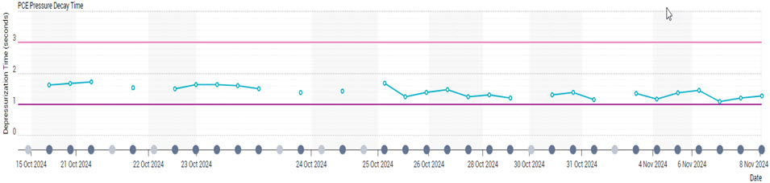
Charts
AIRBUS AMBER
The graph below shows the Pre-Cooler Exchanger (PCE) depressurization time for each flight:
The Y-axis shows the depressurization time in seconds. When the feature is below the threshold, it is considered as an event.
The X-axis shows the flight date.

Slide 13
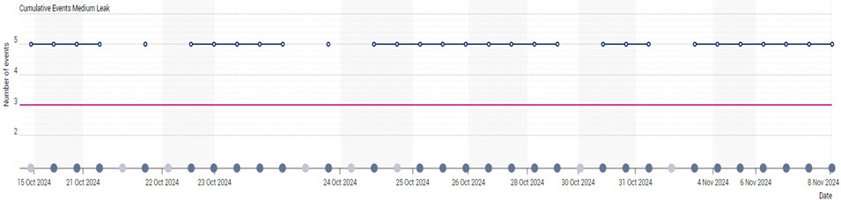
Charts
AIRBUS AMBER
The graph below shows the cumulative events for each flight:
The Y-axis shows the cumulative number of events over a flight window.
The X-axis shows the flight date.

Slide 14
Maintenance advice
AIRBUS AMBER
MEDIUM LEAK ALERT:
If the alert is raised, perform the actions described in the last issue of the Alert Operators Transmission (AOT) - Ref: A36P010-23.
HIGH LEAK ALERT:
If the alert is raised, perform the actions described in the last issue of the Alert Operators Transmission (AOT) - Ref: A36P010-23.

Slide 15
Additional information
AIRBUS AMBER
List of customizable parameters :
Alert priority and justification (LOW, MEDIUM, or HIGH)
  For a maturity at -1 (models operated by Airtac or customer support), the policy for alert priority is
    LOW -> operated by customer support
    MEDIUM / HIGH -> operated by Airtac (SBC2) / digital maintenance operation (SBC6)
  For a maturity at 1 and 3 (service models) the policy for alert priority is
    LOW -> GO MMEL item
    MEDIUM -> GO IF MMEL item
    HIGH -> NO GO MMEL item
Model limitation like temperature range / altitude / part number

Slide 16
Conclusion
AIRBUS AMBER
Deployment review date :
Deployment: GO * 1SYPA will have the control of the alerts and the communications to the airline
Action to be completed prior to model deployment
  Change Alert Priority to LOW as Customer Support will operate the model.
  Maintenance Advice will not be necessary as 1SYPA will communicate with the airline.
  Correct error in SPM chart visualization:
    Duplicated flights
    Invalid flights that show the feature
Foreseen evolution
  Link to model evolution tracker : Model evolution tracker

Slide 17
AIRBUS AMBER
Model information
☒
☐
JIRA reference: SBAOG001-8423
Airlines: ☐ ALL SPM customers ☐ Selected SPM customers
Engine configuration (for SA / LR): ☐ SA CEO-CFM ☐ SA CEO-IAE ☐ SA NEO-CFM ☐ SA NEO-PW / ☐ LR CEO-GE ☐ LR CEO-RR ☐ LR CEO-PW ☐ LR NEO-RR
APU configuration (for SA): ☐ HWL ☐APS
Data type applicability: ☐ADC ☐ACMS R38 ☐ SAR ☐ ACMS report XXX ☐ uplink
User Guide: [Link to User guide]
Model ID: ATA36_XWB_PCE_LEAKAGE_MONITORING_M0
Model tag :
MOCA version: 1.7
[For model evolutions only (not applicable to new models):]
Model evolutions description: quick description to understand what is the change (few lines)
Impact on in-service models: to warn the airline of this impact and avoid questions/complaints for example if it may impact A/L configuration of threshold, or reset the alerting logic

